Slide 1
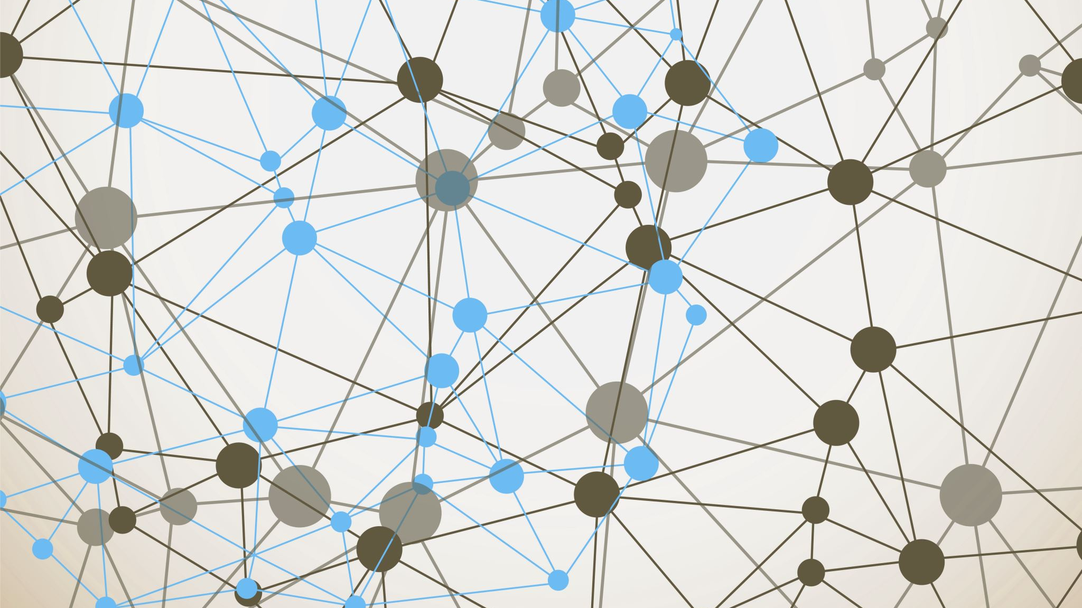
Interactive labs for Machine Learning Cybersecurity Adversarial attack types
By
Deekshith Machidi - 2246684
Monish Kamal Batini - 2250471
Ajay Kumar Reddy Poreddy - 2247259
Vinay Kumar Posina - 2248768

Slide 2
Carlini-Wagner Attack (C&W)
It is more powerful and complex attack that it optimizes a custom loss function to generate examples that are harder to detect while still causing the misclassification.
Attack focuses on finding the smallest perturbation possible to change the classification input.
Attack type:- White- box attack (fully knowledge attacker)

Slide 3
Projected Gradient Descent (PGD):
PGD is considered one of the strongest and most reliable adversarial attacks. It is an extension of BIM, but it projects the perturbed input back into the allowable ε-neighborhood of the original input after each iteration, ensuring that the perturbation remains constrained.
One of the most effective attacks in adversarial training; often used to evaluate model robustness.
Attack Type: White-box attack.

Slide 4
Momentum Iterative Method (MIM)
It is a powerful adversarial attack used to generate adversarial examples that fool neural networks by gradually perturbing input data.
Momentum is incorporated into the attack process to stabilize the gradient-based optimization, allowing for more efficient and effective attacks over multiple iterations.
It works based on the Iterative Attack and Momentum Update

Slide 5

First Gradient Sign Method
What are Adversarial Attacks?
Small perturbations in input data can deceive neural networks.
What is FGSM?
A method to generate adversarial examples by adding perturbations in the gradient direction.

Slide 6
Basic Iterative Method (BIM):
BIM is an iterative version of the FGSM attack. Instead of applying a single perturbation step, it repeatedly applies FGSM over multiple iterations with smaller step sizes, allowing for more refined and effective adversarial examples.
Used for stronger attacks, more likely to bypass simple defenses compared to FGSM.
Attack Type: White-box attack.

Slide 7

Thank you

